Slide 1
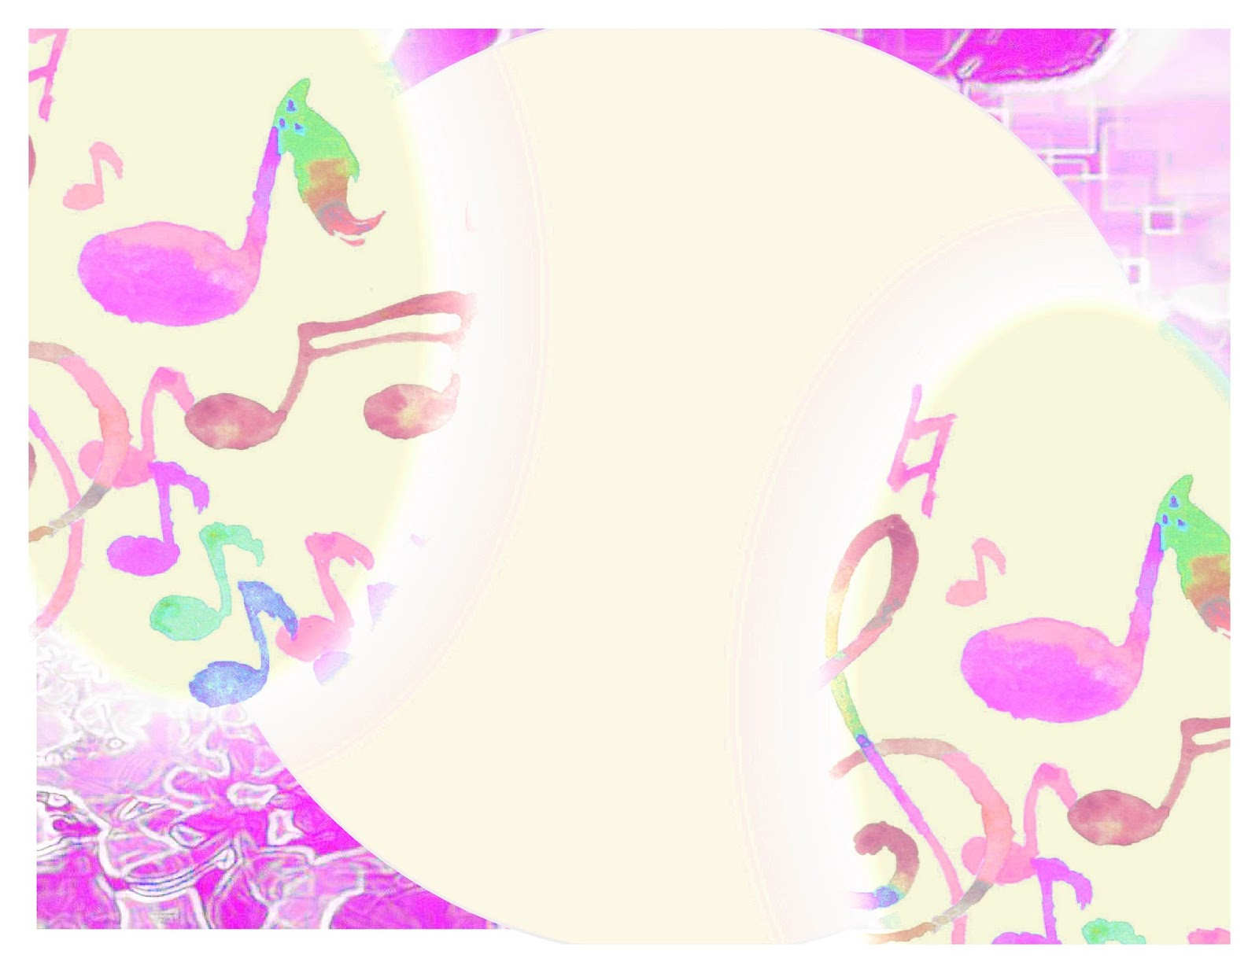
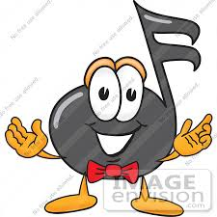
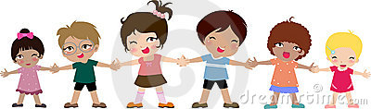
CHILDREN’S OPENING
JANUARY 4, 2015

Slide 2
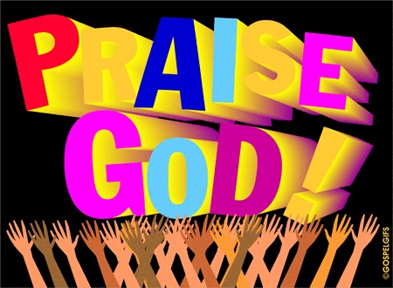
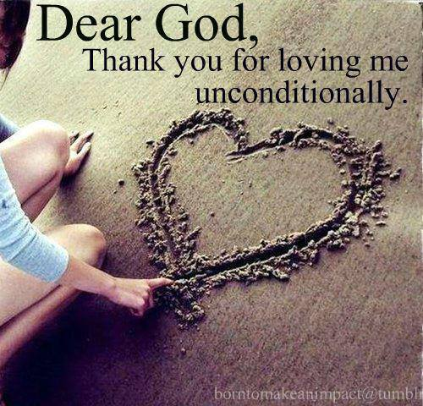
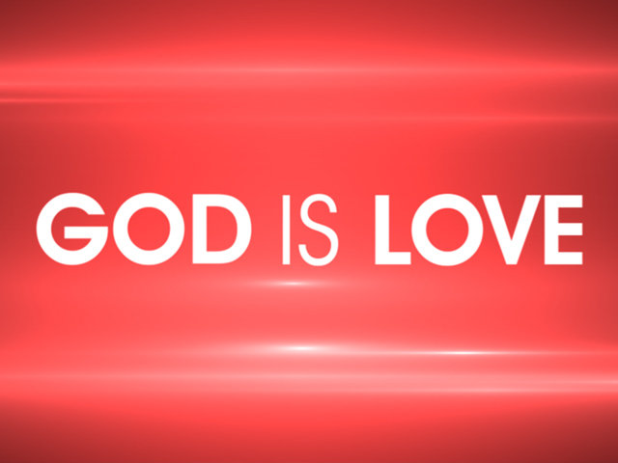
PRAISE HIM, PRAISE HIM
ALL YE LITTLE CHILDREN
GOD IS LOVE! (2x)
(REPEAT)
Change Praise to Thank, Love

Slide 3
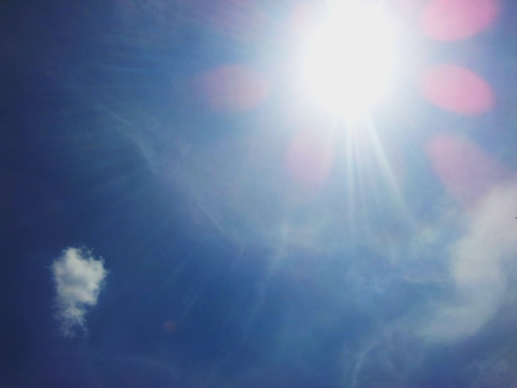
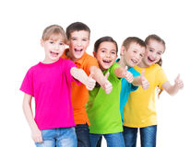
This Is The Day!
This is the day (2X).
That the Lord has made (2X).
We will rejoice (2X).
And be glad in it (2X).
This is the day that the Lord has made.
We will rejoice and be glad in it!
This is the day(2X).
That the Lord has made.

Slide 4

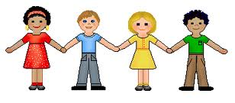
Jesus Loves the Children just like
Me, Me, Me( change )
Jesus Loves the Children just like
Me, Me, Me ( change )
Children just like me
Sat upon His Knee
Jesus Loves the Children just like
Me, Me, Me ( change )
1.Me 2.You 3.Him and Her
Notes:
4

Slide 5
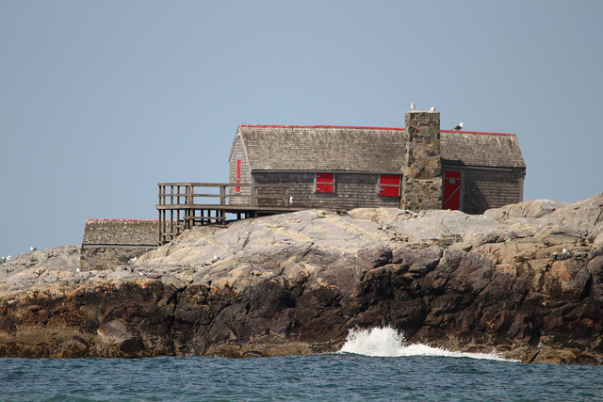
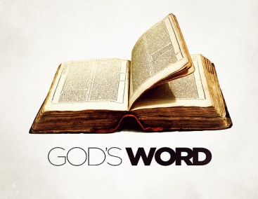
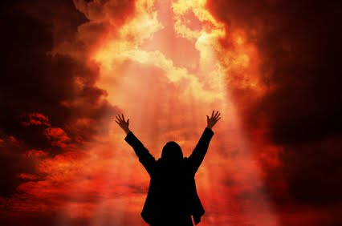
James 1:21b-22a; Matthew 7:24-25
Part One
Receive with meekness
The word implanted
Which can save your souls,
With meekness
The implanted word! (Repeat)
Part Two
Hear my words and do them,
Like a wise man who
Builds his house upon a rock,
It won’t fall down! (repeat)

Slide 6
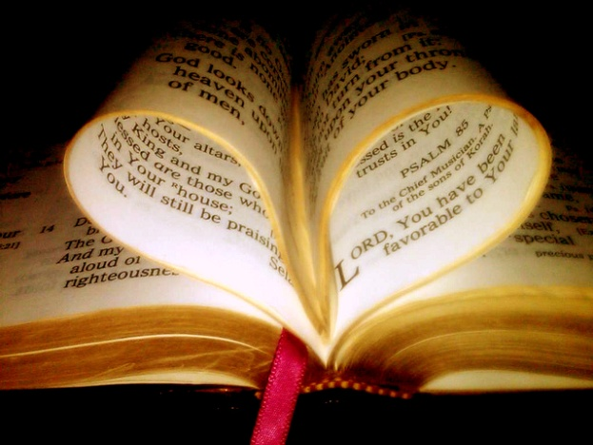
PSALM 119
I
Psalm 119 declares
How precious is God’s word!
Forever settled in the heav’ns (89),
Oh, how I love Your word (97).
Lord, how I love Your word,
More than gold, yes, much fine gold (127);
I joy at Your Word,
I have found great spoil (162),
And delight in Your commands (47).
II
My mouth is opened wide;
I pant, Lord, for Your Word (131)!
Your statutes, Lord, are my delight,
And even my counselors (24).
Your Word is very pure,
That is why I love it so (140),
Your testimonies guide my feet (59)
And teach me the way to go (32a).
III
Your word’s my lamp, my light (105),
I have hidden in my heart
That I may not sin (11),
I’ll cleanse my way
By taking heed to Your Word (9).
Your statutes are my songs (54),
And when I speak Your words,
I won’t be ashamed,
For I love Your Word (46),
I love Your Word, oh, Lord!

Slide 7
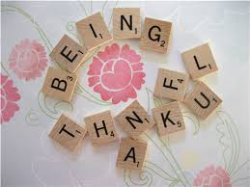

Slide 8
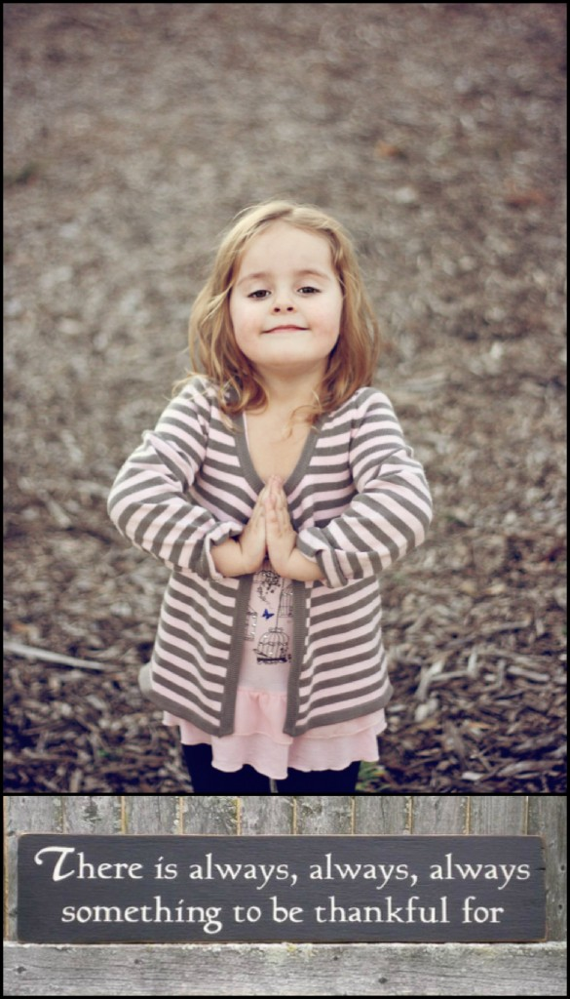
WHAT IS THANKFULNESS?
Definition:
It is an attitude within a person that comes when one is grateful
You have a feeling inside of appreciation and gratitude for something.

Slide 9
WHY SHOULD WE BE THANKFUL?
OLD TESTAMENT
Abraham and Moses built altars in thanksgiving to God.
David was always thank the Lord
Daniel also was one thanking the Lord even though it was against the law
1 Chronicles 16:4
1 Chronicles 16:8
1Chronicles 16:34
Psalm 7:17
Psalm 18:40
Psalm 30:12
2 Samuel 22:50
Daniel 2:23
Daniel 6:10

Slide 10
WHY SHOULD WE BE THANKFUL?
NEW TESTAMENT
The Lord Jesus was also one who gave thanks.
Paul was always giving thanks .
Matthew 11:25
John 11:41
Romans 1:8
Romans 6:17
1 Corinthians 1:4
1 Corinthians 1:14
1 Corinthians 14:18
1Timothy 1:12
2 Timothy 1:3

Slide 11
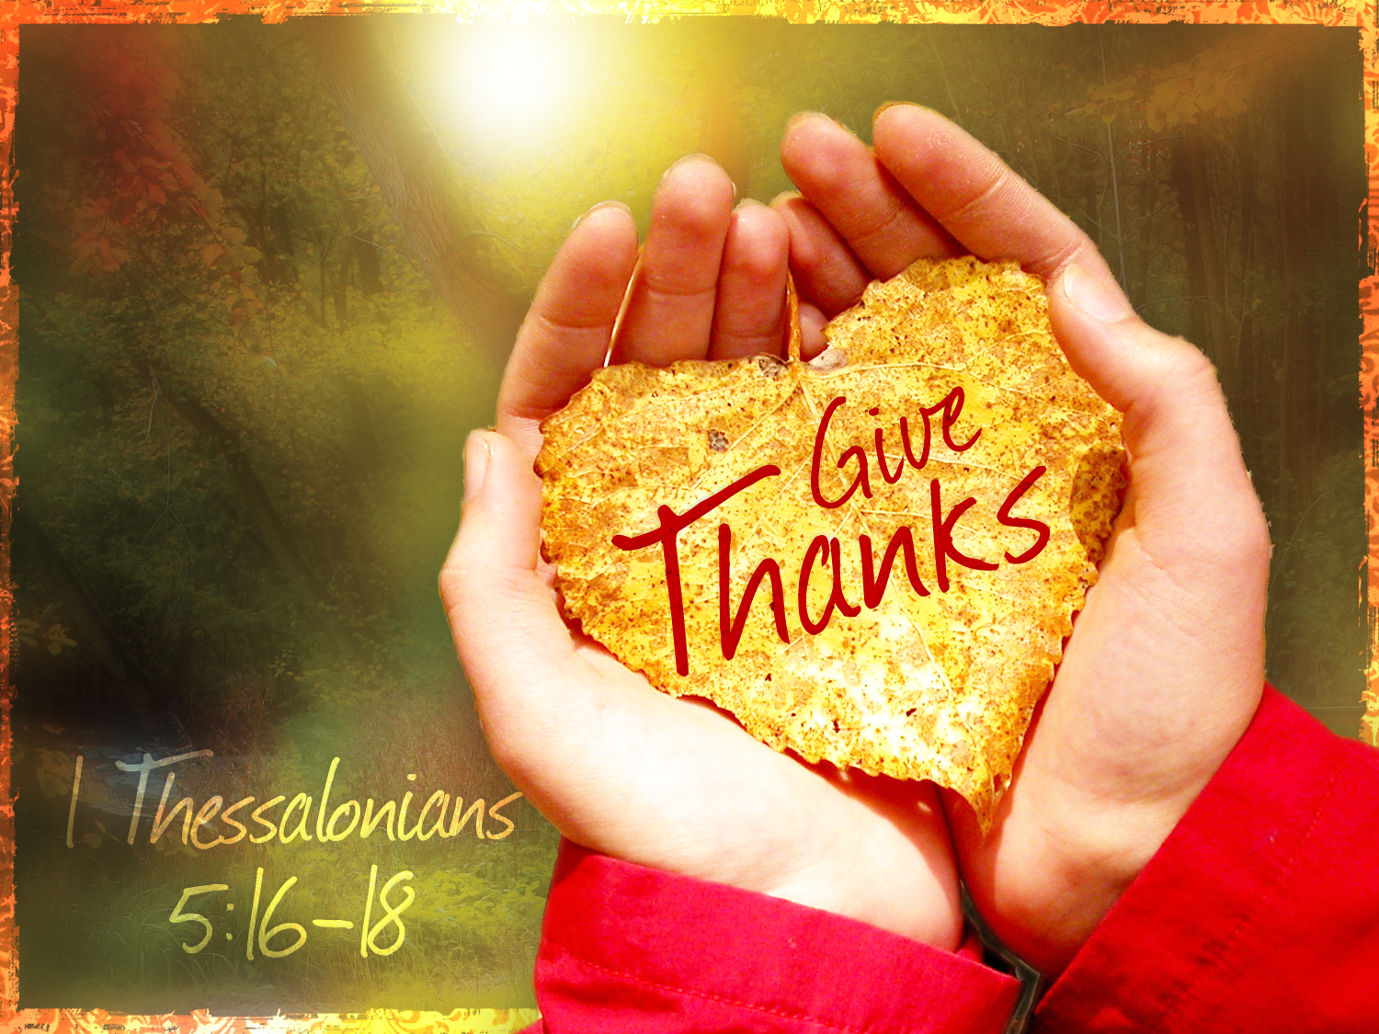

Slide 12



Acts 3: 1-9
Peter and John went to pray
And met a lame man on the way
He asked for alms and held out his palms
And this is what Peter did say:
Silver and Gold have I none
But such as I have give I thee
In the name of Jesus Christ of Nazareth
Rise up and walk!
And he went walking and leaping and praising God!
Walking and leaping and praising God!
In the name of Jesus Christ of Nazareth rise up and walk!

Slide 13
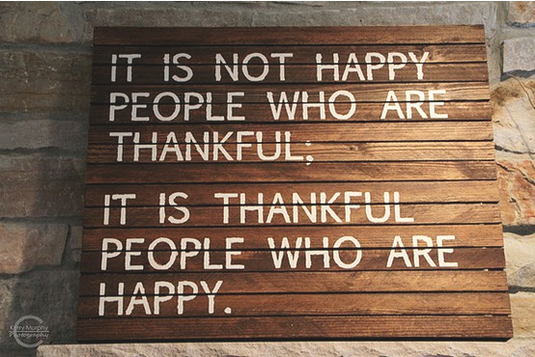
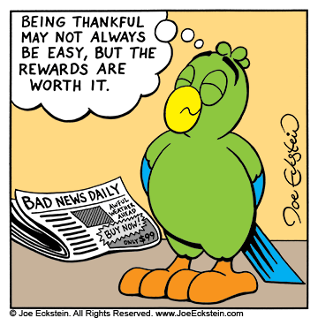
If we are a thankful person, we will be a happy person.
We will feel good inside and feel good about ourselves and our environment

Slide 14

WHAT ARE YOU THANKFUL FOR?

Slide 15
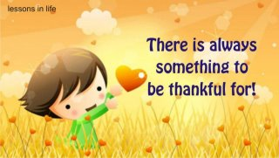
MEMORY VERSE
1 CHRONICLES 16:8
GIVE THANKS TO JEHOVAH; CALL UPON HIS NAME; MAKE KNOWN HIS DEEDS AMONG THE PEOPLES.

